Slide 1
Spotify Based Music Recommendation system
Student Name: Sanyam Rawat
Mentor name: Dr. Hriday Kumar
Institution: Graphic Era Deemed to be University
Date: 12/Jan/2025

Slide 2
Introduction
The music industry is growing exponentially, and personalized music recommendations have become essential for user satisfaction.
Existing systems primarily rely on predefined datasets, limiting their ability to adapt to new or rare songs.
Aim: To develop a dynamic music recommendation system that understands user preferences and suggests both known and unknown songs.

Slide 3
Problem Statement
Current spotify recommendation systems struggle with:
Understanding the nature of the playlist.
Lack of underrated artists.
Lack of personalization for playlist-based recommendations.
Our system addresses these gaps by integrating Spotify's API and advanced similarity metrics.

Slide 4
Methodology (System Architecture)
Data Collection:
Tracks dataset containing features like popularity, genre, release year, and artist.
Spotify API integration to fetch real-time song data.
Data Preprocessing:
Removal of null values and irrelevant features.
Sorting tracks by popularity and removing duplicates.

Slide 5
Methodology (Feature Extraction & Similarity)
Feature Extraction:
Text-based features (genres) processed using CountVectorizer.
Numerical features like tempo, loudness, and danceability.
Similarity Calculation:
Cosine similarity applied to text and numerical vectors.
Weighted combination of similarities to rank recommendations.

Slide 6
Methodology (Playlist-Based Recommendations)
Playlist Input:
Extracts user-provided playlist songs via Spotify API.
Vector Averaging:
Averages features of playlist songs to determine user preferences.
Dynamic Recommendation:
Suggests tracks based on aggregated similarity with the playlist.

Slide 7
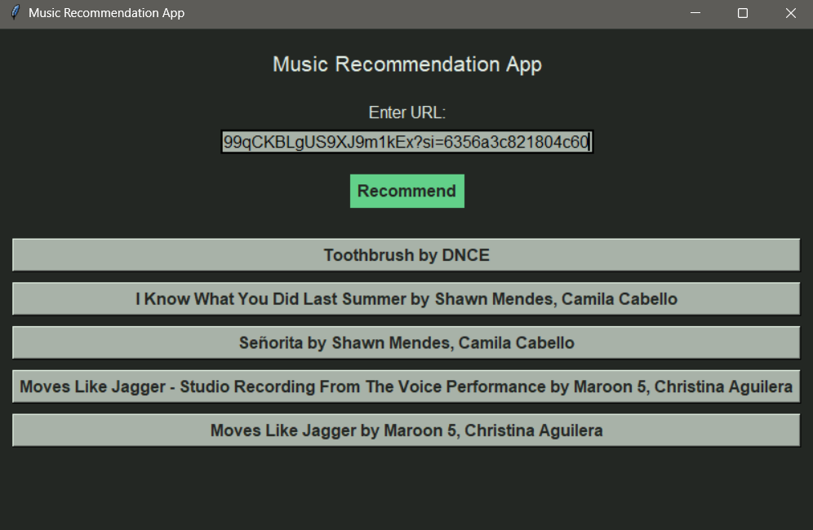
Results
Successfully recommended songs for popular and niche tracks.
Enhanced personalization with playlist-based input.
Visualized features like tempo and loudness distribution to validate dataset quality.
Example Recommendations:

Slide 8
Discussion
Strengths:
Combines text and numeric features for robust similarity analysis.
Adaptable to new datasets via Spotify API.
Limitations:
Dependent on the quality of Spotify data.
May not capture highly subjective user preferences.
User Feedback: Positive response to playlist-based recommendations.

Slide 9
Conclusion
Developed a music recommendation system capable of suggesting both familiar and unfamiliar tracks.
Leveraged Spotify API for dynamic data integration.
Used advanced similarity metrics to enhance recommendation accuracy.

Slide 10
Future Work
Real-Time Recommendations: Incorporate user listening habits in real time.
Deep Learning Models: Explore neural networks for better feature extraction and prediction.
Cross-Platform Integration: Expand functionality to other music platforms.
Improved Personalization: Use sentiment analysis for mood-based song suggestions.

